Slide 1
Build your own Wi-Fi automation lab Pre-lab tasks
Andreas Koksrud / Telenor Bedrift
Kjetil Teigen Hansen / Conscia

Slide 2
References / inspiration
References
https://github.com/CiscoDevNet/yangsuite/
https://postman.com
https://docs.ansible.com/ansible/latest/collections/cisco/ios/ios_facts_module.html
https://www.wifireference.com/2020/01/14/viewing-network-telemetry-from-the-catalyst-9800-with-grafana/
https://grafana.com/grafana/dashboards/13462-device-health-monitoring/
https://grafana.com/grafana/dashboards/12468-catalyst-9800-client-stats/
https://wirelessisfun.wordpress.com/2020/12/10/network-telemetry-data-and-grafana-part-1-the-advanced-netconf-explorer/
https://python.org
https://codeium.com

Slide 3
Copyright
Copyright
© Andreas Koksrud 2024. All rights reserved. This presentation is provided for educational and informational purposes only. You may distribute and learn from this presentation, but commercial use or any form of monetization is strictly prohibited without prior written consent.
Any slides marked Kjetil Teigen Hansen or the Conscia logo will also have full or co-ownership by Kjetil.

Slide 4
Prerequisites
Communications
Cisco.com account with access to downloading WLC (9800-CL at https://software.cisco.com)
Postman account (https://postman.com)
Windows laptop with administrative privileges
For now, we will include some preliminary instructions for Mac
What will definitely NOT work on Mac, is running the C9800 WLAN Controller
Complete the pre-lab exercises (this document) before the deep dive labs
Without these, parts of the Deep Dive might be difficult to complete, or steps might differ severely

Slide 5

Communications
Communications
WebEx space: Wi-Fi automation lab
Please help each other
Sharing is caring ☺

Slide 6
Agenda
Agenda
Pre-lab
Install VirtualBox
Install Cisco 9800-CL
Install Ubuntu Server w/Docker
Install Postman
Install VS Code
Day 1
Day 2
In-depth explore a topic of choice
Sort out pre-lab task problems
Grafana / TIG-stack
Grafana Cloud
Ansible
Python
Other vendors (MIST/Meraki/Aruba)
Get to know the lab environment
Configure your AP
Connect VS Code to Ubuntu
Install and explore Ansible
Explore Python automation
Install and explore YANG Suite
Explore Postman
Install and explore Grafana

Slide 7
Scope
Scope
In scope
Getting started with various systems/languages/solutions for lab purposes
Get a lab environment up and running on your own laptop
Some nice examples to try various aspects of automation
Inspiring you to explore deeper on your own
Out of scope topics
Git
Learning the languages (Ansible, Python, InfluxQL, etc)
Learning Linux
Deploying the systems for production use

Slide 8
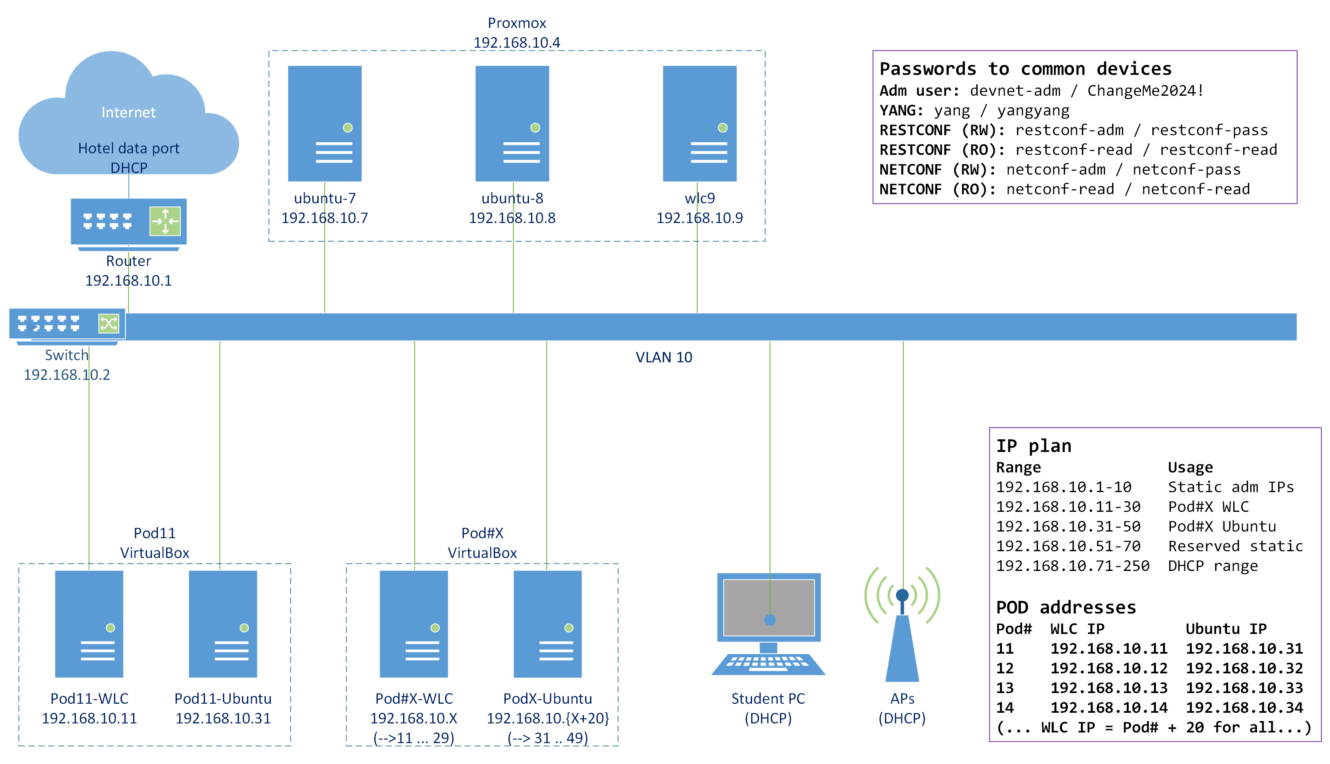
Topology
Lab topology

Slide 9
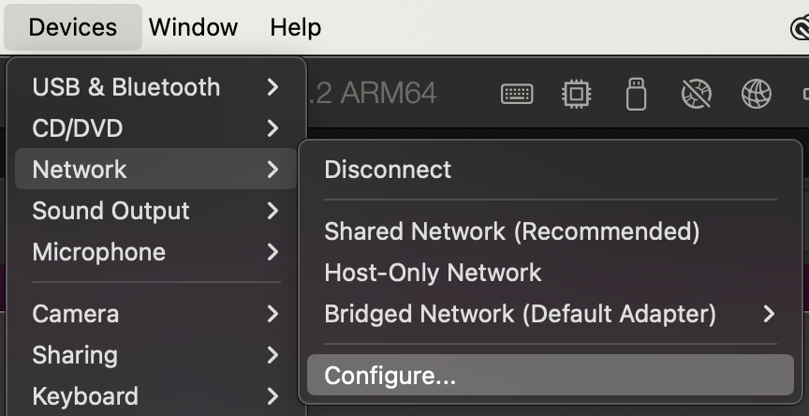
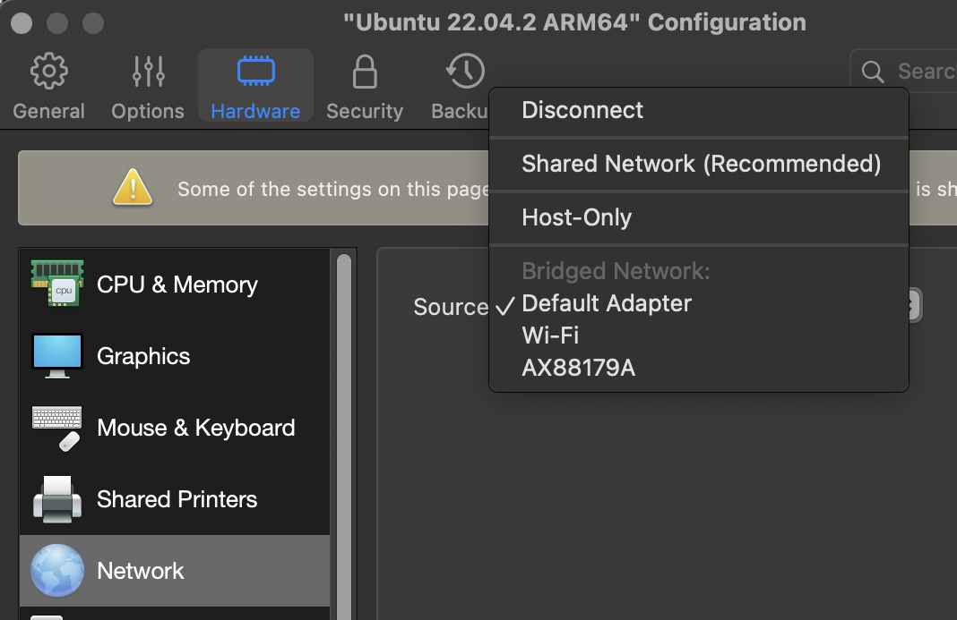
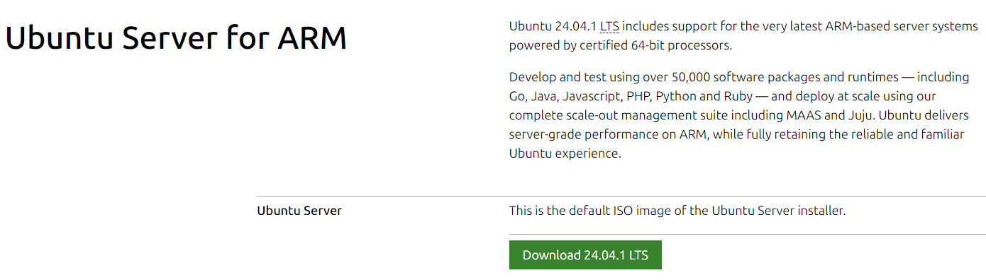
Notes for Mac users #1 - Ubuntu VM
Notes for Mac users
If you are using a newer MacOS
No VirtualBox version available for MacOS with Apple silicon (only for x86), as of Oct 2024
You can run Ubuntu in Parallels, you will need the ARM64 version of Ubuntu Server
Detailed instructions will not be provided, but in general it will be the same, including network adapter in bridged mode
Since we are not Mac people, in this first version of the deep dive, no detailed instructions for Mac installation will be provided. It might be added in a future version
Do not install the pre-selected "Ubuntu" in Parallels, it is the Desktop version with GUI and lots of preloaded programs. Good for its use, but not neccessary for this lab. It will not hurt, but the instructions will not match this guide.
Link to Ubuntu Server for ARM64: https://ubuntu.com/download/server/arm
If you would rather use an Ubuntu Server hosted on our VM, just give us a hint and we will prepare one for you ☺

Slide 10
Notes for Mac users #2 - Cisco 9800 WLC
Notes for Mac users
As of now, 9800-CL will NOT run on Macs with Apple silicon. You can use the shared installation wlc9 (see topology)
If many people need to use a hosted WLC, we can create "your own" 9800 in our virtual environment
No instructions will be supplied from our side for getting a 9800 to run on older Macs with Intel silicon, but you should be able to get it to work using VirtualBox (which is supported on Intel silicon Macs). Or you can follow this blog post from Francois:
https://semfionetworks.com/blog/setup-cisco-catalyst-9800-controller-on-your-laptop/

Slide 11
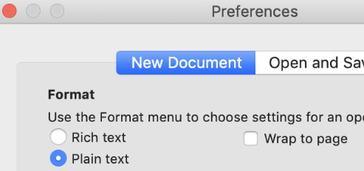
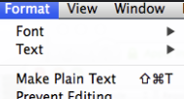
Notes for Mac users #3 - TextEdit
Notes for Mac users
TextEdit (the default text editor on OS X) use rich text formatting by default. This is not a great idea when copy-pasting stuff to the command line, so there is a couple of things you must keep in mind
If you want, you can change a setting in TextEdit to make all new documents plain text
To change the current document to plain text go to Format -> Make Plain Text
Shortcut is: Shift-Cmd-T

Slide 12
Notes for WSL users (optional / alternative)
Notes for Mac users
You can use WSL (Windows Subsystem for Linux) instead of a Ubuntu VM running in VirtualBox for Python and Ansible stuff
TIG stack and other docker stuff is not tested (yet)
No instructions for using WSL or adopting the lab guide to WSL is included at this moment
Install WSL (start Powershell as administrator)
Check WSL version
Upgrade WSL
Install Ubuntu, run "wsl --install -d Ubuntu
List installed WSL VMs, run "wsl --list"
Fix network connectivity (from Powershell. Restart WSL)
Set Windows user home directory as WSL home directory
Do this inside the WSL Ubuntu terminal
Find this line
Edit the home directory to your Windows home directory
Edit the wsl.conf file inside Ubuntu
Add the following part
Copy the bash profile files to your new home directory (after re-login)
PS C:\> echo '[wsl2]' > ~\.wslconfig
PS C:\> echo 'networkingMode=mirrored' >> ~\.wslconfig
PS C:\> wsl --install
koks@TNL-15143nc81:~$ sudo nano /etc/passwd
koks:x:1000:1000:,,,:/home/koks:/bin/bash
PS C:\> wsl --version
WSL version: 2.3.24.0
(... if this command is not showing version, you must upgrade)
koks:x:1000:1000:,,,:/mnt/c/Users/akoksrud:/bin/bash
PS C:\> wsl --update
koks@TNL-15143nc81:~$ sudo nano /etc/wsl.conf
[automount]
options = "metadata"
PS C:\> wsl --install -d Ubuntu
PS C:\> wsl --list
koks@TNL-15143nc81:~$ cp /home/koks/.bashrc ~
koks@TNL-15143nc81:~$ cp /home/koks/.profile ~

Slide 13
I only want the "automation" part, not the "building your own lab" part
I only want the "automation" part, not the "building your own lab" part
If you for some reason do NOT want to do the "building your own automation lab" part of this deep dive, only the "a taste from the automation buffet" part, you can skip some parts. We will try to note those parts at the intro slide to each part.
In short, you can make these decisions to do less building and more automation
Use an Ubuntu server that we can host on a server that we bring along. This will be "your own" and we will delete it after the deep dive. The resources will be shared along with some other participants and the shared WLC
Use a C9800 WLC on a server that we bring along. This WLC will be shared by all students that need this. We might be able to host some more WLCs if neccessary
Instead of installing YANG Suite you can use it from a shared Ubuntu Server where it is already installed
Instead of installing the TIG stack (Grafana etc) you can use it from a shared Ubuntu Server where it is already installed
Please note that by doing this you might have more time for automation during the deep dive, but you will be less familiar with building the items yourself when you get home or need it in some other situation.

Slide 14
Pre-lab task #1: VirtualBox
Pre-lab task #1: VirtualBox
In this task we will install VirtualBox
This lab will use VirtualBox to run virtual machines (VMs) on your laptop
Cisco C9800-CL Wireless LAN Controller
Ubuntu Linux with Docker to run some different containers
RightCtrl + F switches between full-screen and window
Tap RightCtrl to "free" input from guest
!!! Note !!!
As a rule of thumb when running VMs, you should turn OFF power save stuff on your laptop, as you might run into unexpected problems if your laptop enters power saving modes
(optional info)
The Python-based exercises can also be run directly on your host OS Python-environment. But a VM give flexibility to test stuff without messing with your production OS. Ansible can not (currently) be run on Windows so it needs a Linux VM to run. The TIG-stack could also be run on the host OS, but again for lab purposes a VM is much easier to just wipe if (when) you test some weird stuff that breaks everything.
You can also use WSL (Windows Subsystem for Linux), which might be just as good or better in many situations. But this lab covers the use of a VM on VirtualBox ☺

Slide 15

Alternative solutions - Shared servers
Pre-lab task #1: VirtualBox
Shared servers
I bring with me a portable datacenter (i.e. my old work laptop...) where I have installed Proxmox Virtual Environment. On that, I have installed a C9800, and a couple of Ubuntu servers
If you for any reason are unable to spin up 9800 or Ubuntu on your own laptop, just notice me and you kan use the shared servers
If you do not have admin privileges, VirtualBox will not work
If your laptop is weak, you might be able to run Ubuntu server, but can use the shared WLC on proxmox (wlc9, see topology)
1x 9800 and 3-4 Ubuntu servers should run fine (we might test with more if neccessary)

Slide 16
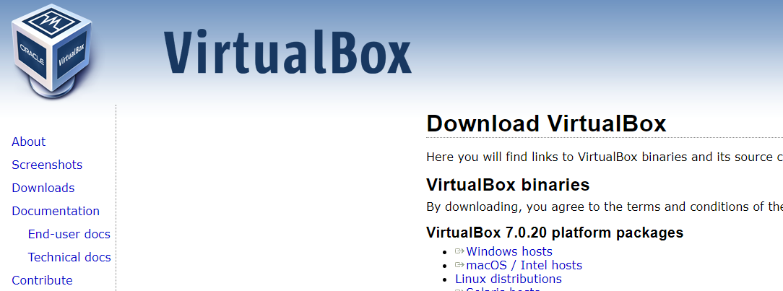
VirtualBox installation
Pre-lab task #1: VirtualBox
https://virtualbox.org/
Needs admin privileges
Not all steps are shown here, it is mostly "Next-next-next"
As default folder for VMs, I use "C:\Virtual Machines", you can use whatever, but screenshots here will show this path

Slide 17
VM Networking
Pre-lab task #1: VirtualBox
Here is a general overview of different modes of networking
Bridged Adapter (used in this lab)
Each VM gets an IP alongside your host, directly on the network
Switchports must accept multiple mac addresses from each host
For APs to connect to 9800, I prefer this rather than NAT'ing through your host
Also, for WLCs to connect to Ubuntu (for telemetry), I also prefer this over NAT'ing
NAT Network (not covered in this lab)
Host IP is shared as outside IP
VMs get IP addresses on a NAT’ed network pool
NAT Network is created under File -> Tools -> Network Manager -> NAT Networks
You must create Port Forwarding rules (in the NAT Networks config) to allow traffic from host to guest VMs
NAT (not covered in this lab)
Host IP is shared as outside IP
VM can only reach internet, not the other VMs
Host and guest can not reach each other on IP, only the VirtualBox console

Slide 18
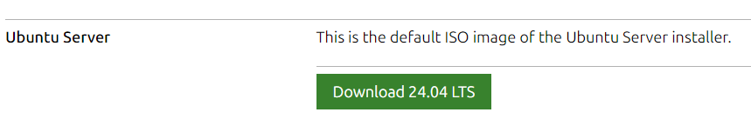
Pre-lab task #2: Ubuntu Server
Pre-lab task #2: Ubuntu Server
Download Ubuntu Server 24.04
https://ubuntu.com/download/server
If using MacOS, download the ARM64 version, and use Parallels
https://ubuntu.com/download/server/arm
If using MacOS, see slide 10 "Alternative solutions" for network interface config on the Parallels side

Slide 19
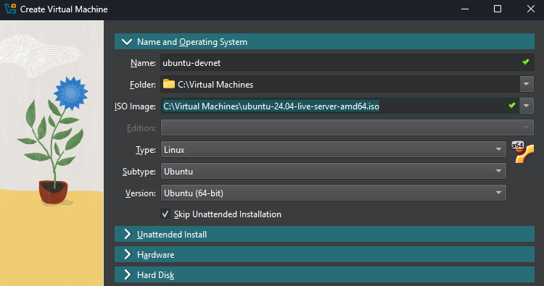
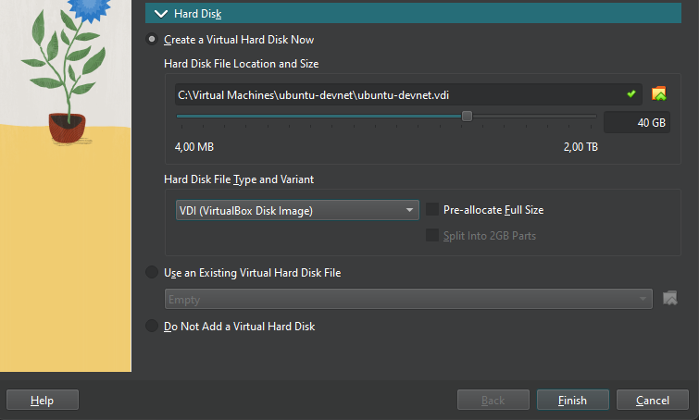

Create Ubuntu server (VirtualBox GUI screenshots)
Pre-lab task #2: Ubuntu Server
Set the name, folder and select the ISO that you downloaded
Select Type as shown
Check «Skip Unattended Installation»
Expand the «Hardware» section. Increase to 4096MB
Expand the «Hard Disk» section. Increase to 40GB, then Finish

Slide 20
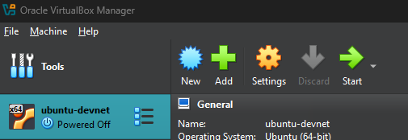
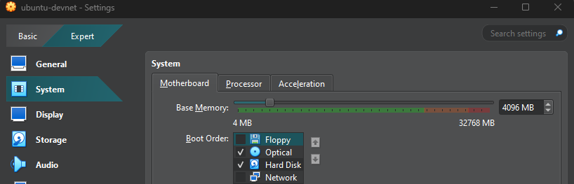
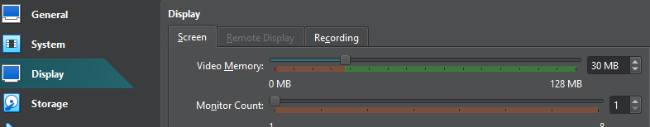
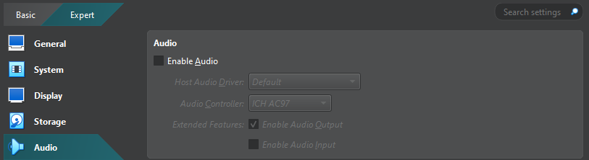
Create Ubuntu server (VirtualBox GUI screenshots)
Pre-lab task #2: Ubuntu Server
Enter settings
General: No change needed
System: Remove «Floppy» checkbox. Keep the rest default
Display: Ensure «Video Memory» is at least 30MB. Keep the rest default
Storage: No change needed
Audio: Remove «Enable Audio» checkbox

Slide 21
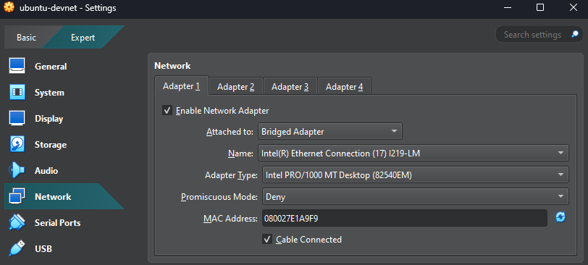
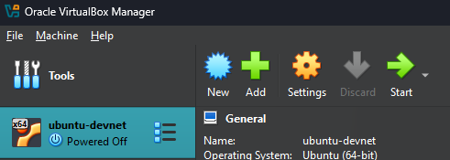
Create Ubuntu server (VirtualBox GUI screenshots)
Pre-lab task #2: Ubuntu Server
Network:
Change «Attached to» for Adapter 1 to «Bridged Adapter»
Change «Name», select your Ethernet adapter
Keep the rest as default
Do not enable Adapater 2, 3 or 4
Click OK to save the changes
Start the VM
(here you can also choose «Headless Start» at a later stage when your VM have got its static IP so you would only use SSH)

Slide 22
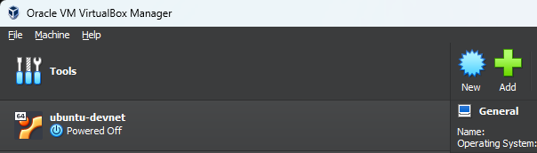
Installing Ubuntu Server (optional - CLI alternative)
Pre-lab task #2: Ubuntu Server
Start PowerShell
Go to folder where you have your VMs
The example uses 'c:\Virtual Machines', change to your directory accordingly
cd ‘c:\Virtual Machines\’
Create and start the VM, follow these instructions
(copy-paste is possible from this box)
PS C:\> cd 'Virtual Machines'
PS C:\Virtual Machines>
PS C:\Virtual Machines> VBoxManage createvm --name "ubuntu-devnet" --ostype Ubuntu_64 --register
PS C:\Virtual Machines> VBoxManage modifyvm "ubuntu-devnet" --cpus 1 --memory 4096 --vram 30 --graphicscontroller vmsvga --usbohci on --mouse usbtablet --pae off --boot1 disk --boot2 dvd --boot3 none --audio-enabled off
PS C:\Virtual Machines> VBoxManage createhd --filename ".\ubuntu-devnet\ubuntu-devnet.vdi" --size 40000 --variant Standard
PS C:\Virtual Machines> VBoxManage storagectl "ubuntu-devnet" --name "SATA Controller" --add sata --bootable on
PS C:\Virtual Machines> VBoxManage storageattach "ubuntu-devnet" --storagectl "SATA Controller" --port 0 --device 0 --type hdd --medium ".\ubuntu-devnet\ubuntu-devnet.vdi"
PS C:\Virtual Machines> VBoxManage storagectl "ubuntu-devnet" --name "IDE Controller" --add ide
PS C:\Virtual Machines> VBoxManage storageattach "ubuntu-devnet" --storagectl "IDE Controller" --port 0 --device 0 --type dvddrive --medium ".\ubuntu-24.04-live-server-amd64.iso"
PS C:\Virtual Machines> ipconfig /all
<<< Copy the "Description" for the NIC you will use. For me it is "Intel(R) Ethernet Connection (7) I219-LM" >>>
PS C:\ Virtual Machines> VBoxManage modifyvm "ubuntu-devnet" --nic1 bridged --cable-connected1 on --bridgeadapter1 "Intel(R) Ethernet Connection (7) I219-LM"
PS C:\ Virtual Machines> VBoxManage startvm "ubuntu-devnet"

Slide 23
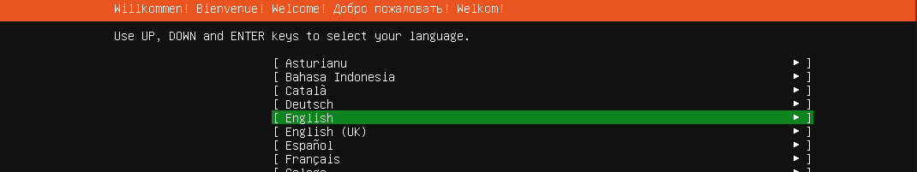
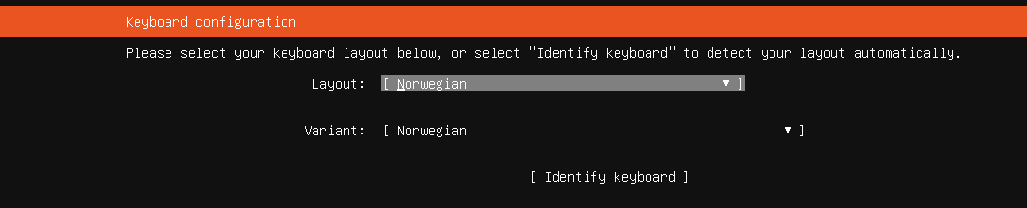
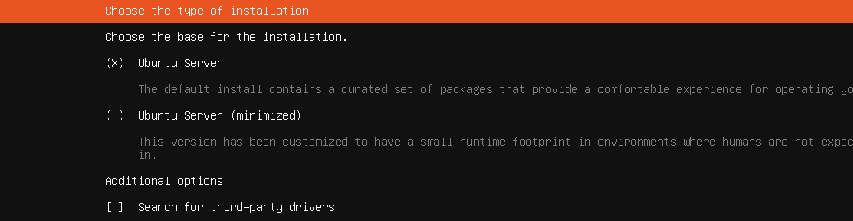
Ubuntu server install
Pre-lab task #2: Ubuntu Server
Frequent updates to Ubuntu can make the following pages somewhat different, but the basics should be recognizable
If asked to update the installer you can do this, it won’t really matter much
Choose your own keyboard layout (unless you just love the norwegian æøå characters and funky placement of all the useful characters like dash and slash)

Slide 24
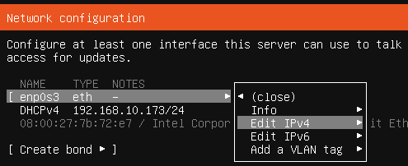
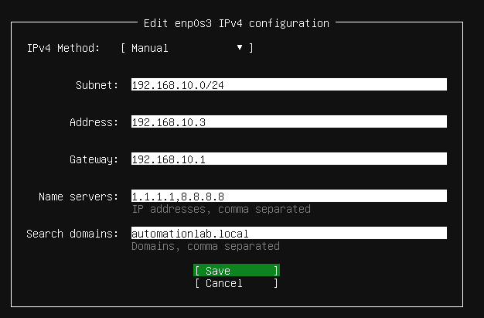
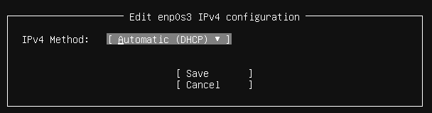
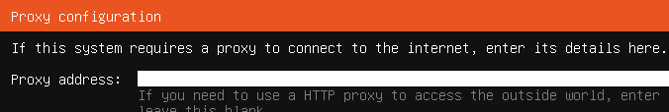
Ubuntu server install - Network configuration
Pre-lab task #2: Ubuntu Server
For pre-lab install you can use DHCP or static IP in your own environment. When in the lab environment, you can change to (another) static IP. See later slide on static vs DHCP.
Leave this blank

Slide 25
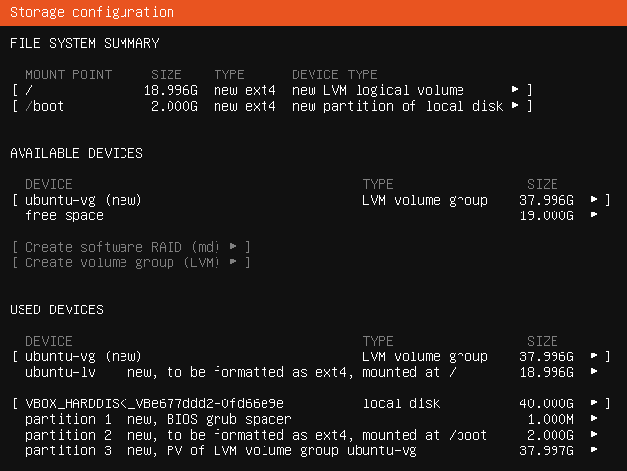
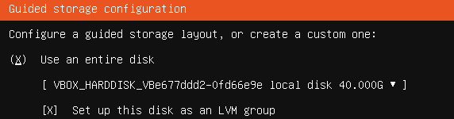

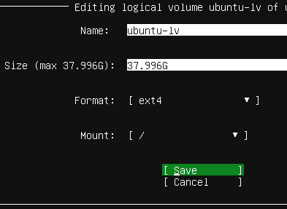
Ubuntu server install - Disk usage
Pre-lab task #2: Ubuntu Server
!!! When you encounter the disk usage screen, please take a little care and follow these steps !!!
If not, you will only use about 50% of the allocated disk
In the first screen, choose "Use an entire disk" (default)
At the next screen, select the "ubuntu-lv" option
Press Enter, select Edit
Change the "Size" to the max value and save
(optional) IF you have forgotten this, here are the commands to extend the size later
devnet-adm@ubuntu-devnet:~$ sudo lvdisplay | grep "LV Path"
LV Path /dev/ubuntu-vg/ubuntu-lv
devnet-adm@ubuntu-devnet:~$ sudo lvextend -l +100%FREE /dev/ubuntu-vg/ubuntu-lv
devnet-adm@ubuntu-devnet:~$ df -h | grep "lv"
/dev/mapper/ubuntu--vg-ubuntu--lv 37G 14G 22G 39% /
devnet-adm@ubuntu-devnet:~$ sudo resize2fs /dev/mapper/ubuntu--vg-ubuntu--lv

Slide 26
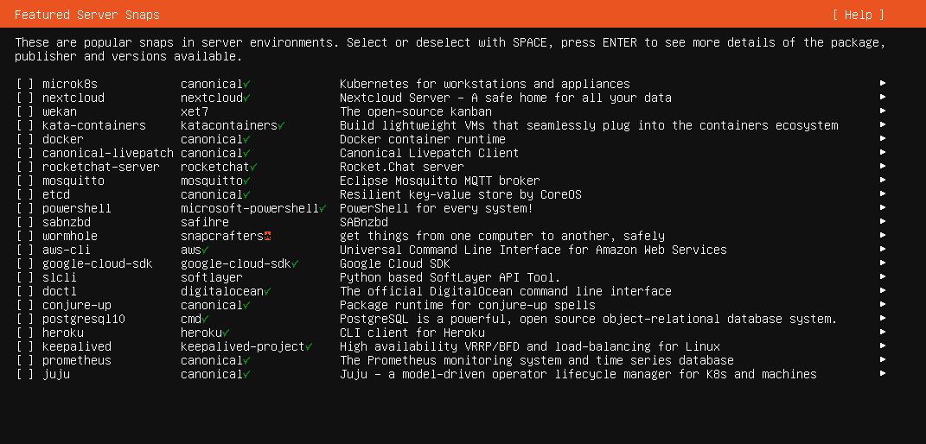
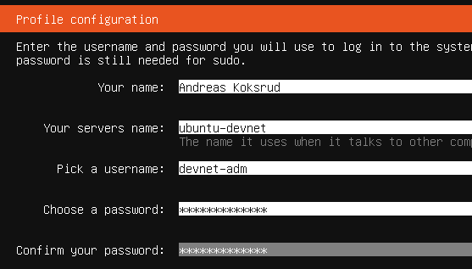
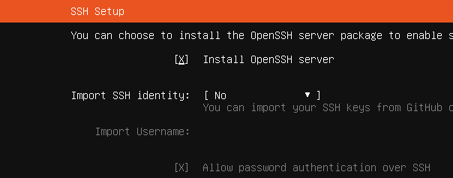
Ubuntu server install
Pre-lab task #2: Ubuntu Server
On the next pages, just keep the defaults and move on, until you reach this page
After «Installation complete» and «Reboot Now» you will get this screen. You should continue by just pressing Enter
ChangeMe2024!
ChangeMe2024!

Slide 27
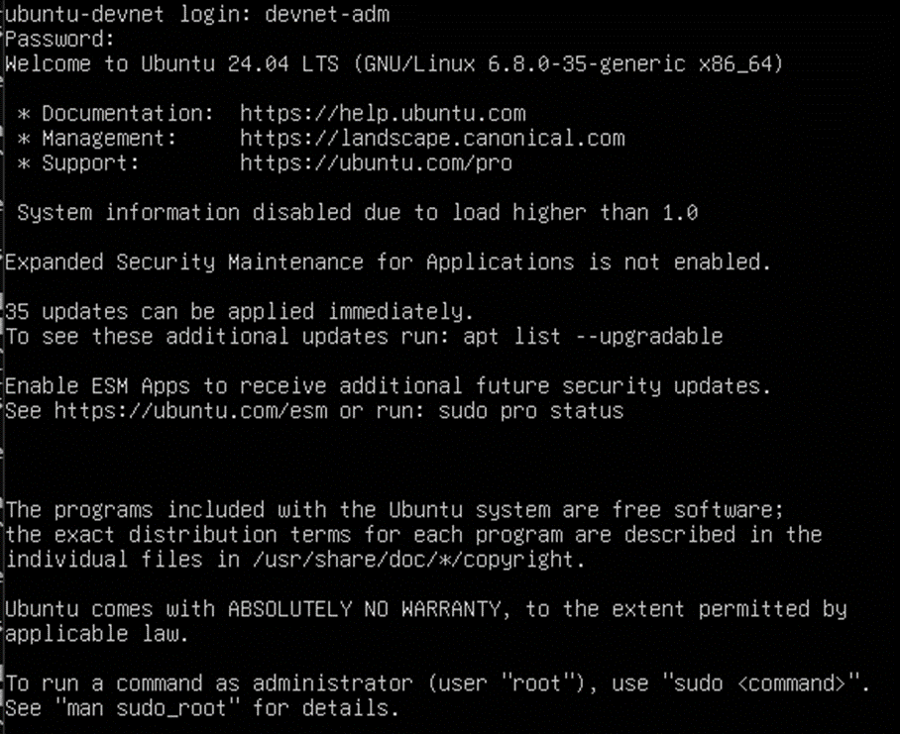
Ubuntu server install
Pre-lab task #2: Ubuntu Server
At first boot it will look like this
Run these commands to upgrade all packages to the latest version
devnet-adm@ubuntu-devnet:~$ sudo apt update
devnet-adm@ubuntu-devnet:~$ sudo apt upgrade

Slide 28
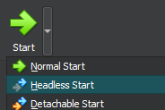

Connecting to the server using SSH
Pre-lab task #2: Ubuntu Server
Now would be a great time to connect to the Ubuntu server using your favourite SSH client. Like MobaXterm, SecureCRT, PuTTY, etc. You can also use the ssh CLI tool in your preferred shell
The main reason for this is copy-paste, which you will use during these pre-lab tasks, and much more in the deep dive itself ☺ It might be possible to get good copy-paste behavior in the VirtualBox console, but the eventual instructions for that is still "to-be"☺
If you have static IP and SSH up and running, the next time you reboot your Ubuntu Server, you could use "Headless Start" to prevent the console window pop-up.
If you need the console when started headless, just use the "Show" button found where the Start button usually is before the VM is started

Slide 29
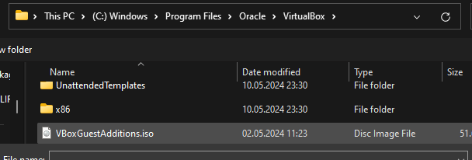
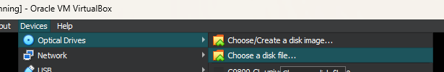
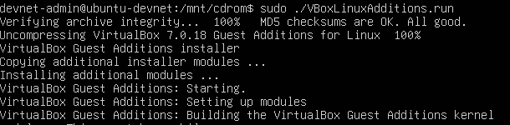
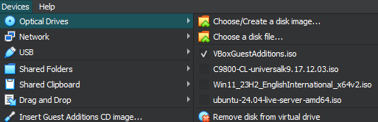
VirtualBox Guest Additions
Pre-lab task #2: Ubuntu Server
RightCtrl + F switches between full-screen and window
Tap RightCtrl to "free" input from guest
devnet-adm@ubuntu-devnet:~$ sudo apt install build-essential dkms linux-headers-$(uname -r)
devnet-adm@ubuntu-devnet:~$ sudo mkdir -p /mnt/cdrom
devnet-adm@ubuntu-devnet:~$ sudo mount /dev/cdrom /mnt/cdrom
mount: /mnt/cdrom: WARNING: source write-protected, mounted read-only.
devnet-adm@ubuntu-devnet:~$ cd /mnt/cdrom
devnet-adm@ubuntu-devnet:~$ sudo ./VBoxLinuxAdditions.run
devnet-adm@ubuntu-devnet:~$ sudo reboot

Slide 30
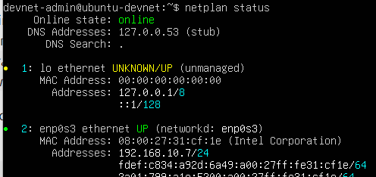
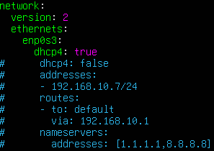
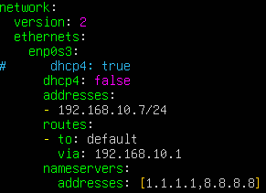
Pre-lab task #2: Ubuntu Server
99_config.yaml
!!! In YAML, indentation is REALLY important !!!
network:
version: 2
ethernets:
enp0s3:
dhcp4: true
# dhcp4: false
# addresses:
# - 192.168.10.{YOUR_POD_IP}/24
# routes:
# - to: default
# via: 192.168.10.1
# nameservers:
# addresses: [1.1.1.1,8.8.8.8]
Static IP vs DHCP
One method to change between DHCP and static IP, is to edit the YAML files in /etc/netplan/
We just create a new file called 99_config.yaml, and when we run "netplan apply" it will use that file for config. We delete the auto-created "50-cloud-init.yaml"
(example with DHCP)
Change this to whatever name you have here
For simplicity, I usually just comment out the parts that I don't use.
For DHCP I comment out the lines related to static
For static config I comment the line "dhcp4: true" and uncomment the rest
(example with static IP)
devnet-adm@ubuntu-devnet:~$ sudo nano /etc/netplan/99_config.yaml
(copy-paste from the example in the top right corner, then save and quit)
devnet-adm@ubuntu-devnet:~$ sudo chmod 600 /etc/netplan/99_config.yaml
devnet-adm@ubuntu-devnet:~$ ls -l /etc/netplan/
total 8
-rw------ 1 root root 593 Sep 04 13:35 50-cloud-init-yaml
-rw------ 1 root root 85 Sep 08 15:46 99_config.yaml
(... cut for brevity ...)
devnet-adm@ubuntu-devnet:~$ sudo rm /etc/netplan/50-cloud-init.yaml
devnet-adm@ubuntu-devnet:~$ sudo netplan apply

Slide 31
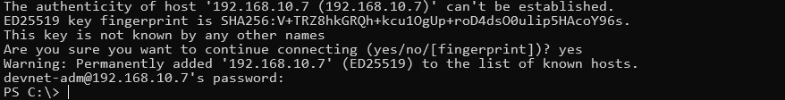
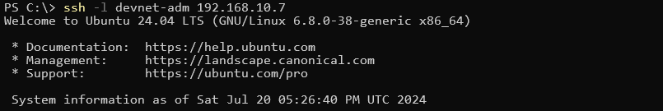
Create an SSH key -> Import to Ubuntu keystore
Pre-lab task #2: Ubuntu Server
Start by opening Powershell (not CMD for this task)
Then, logging in to your Ubuntu Server using SSH
Create SSH key for your user
Copy the public part of your key to Ubuntu
Reference: https://code.visualstudio.com/docs/remote/ssh-tutorial
PS C:\> ssh -l devnet-adm 192.168.10.7
devnet-adm@ubuntu-13:~$ exit
Change to your
server's IP
PS C:\> ssh-keygen -t ed25519
PS C:\> type ~\.ssh\id_ed25519.pub | ssh -l devnet-adm 192.168.10.7 "cat >> .ssh/authorized_keys"

Slide 32
Pre-lab task #2: Ubuntu Server
Git clone the example files
devnet-adm@ubuntu-devnet:~$ cd ~
devnet-adm@ubuntu-devnet:~$ git clone https://github.com/akoksrud/wifi-automation
Cloning into 'wifi-automation'...
remote: Enumerating objects: 20, done.
remote: Counting objects: 100% (20/20), done.
remote: Compressing objects: 100% (15/15), done.
remote: Total 20 (delta 2), reused 15 (delta 1), pack-reused 0
Receiving objects: 100% (20/20), 15.61 KiB | 841.00 KiB/s, done.
Resolving deltas: 100% (2/2), done.
devnet-adm@ubuntu-devnet:~$ cd wifi-automation
devnet-adm@ubuntu-devnet:~$ ls -l
total 52
drwxrwxr-x 2 devnet-adm devnet-adm 4096 Jul 1 18:38 examples
-rw-rw-r-- 1 devnet-adm devnet-adm 35149 Jul 1 18:38 LICENSE
drwxrwxr-x 2 devnet-adm devnet-adm 4096 Jul 1 18:38 presentation
-rw-rw-r-- 1 devnet-adm devnet-adm 63 Jul 1 18:38 README.md
drwxrwxr-x 2 devnet-adm devnet-adm 4096 Jul 1 18:38 solutions
devnet-adm@ubuntu-devnet:~$
Git will not be used for version control or backup in this lab, but it is highly recommended to use when building your own projects
To update the contents of the cloned repository, do a git pull like this
devnet-adm@ubuntu-devnet:~$ git pull origin main

Slide 33

Pre-lab task #3: Install Docker on the Ubuntu Server
Pre-lab task #3: Docker
Installing Docker on Ubuntu Server
Docker is a platform for running containers (isolated/controlled environments)
As Docker containers we will run
YANG-Suite to explore IOS-XE YANG models
Telegraf, InfluxDB and Grafana to visualize Telemetry data from IOS-XE
We will use "docker-compose" for our container setups
All settings for a container specified in a YAML file
To test the Docker installation, we will run
hello-world, a very small container that outputs "Hello from Docker!" if Docker is correctly installed
alpine, a very small footprint linux container

Slide 34
Installing docker
Pre-lab task #3: Docker
Copy-paste should be OK from this slide, but it doesn't always like if you copy-paste the full content at once, so just do it in some separate chunks
# Add Docker's official GPG key:
sudo apt update
sudo apt install ca-certificates curl gnupg
sudo install -m 0755 -d /etc/apt/keyrings
curl -fsSL https://download.docker.com/linux/ubuntu/gpg | sudo gpg --dearmor -o /etc/apt/keyrings/docker.gpg
sudo chmod a+r /etc/apt/keyrings/docker.gpg
# Add the repository to Apt sources:
echo \
"deb [arch="$(dpkg --print-architecture)" signed-by=/etc/apt/keyrings/docker.gpg] https://download.docker.com/linux/ubuntu \
"$(. /etc/os-release && echo "$VERSION_CODENAME")" stable" | \
sudo tee /etc/apt/sources.list.d/docker.list > /dev/null
sudo apt update
# Install Docker:
sudo apt-get install docker-ce docker-ce-cli containerd.io docker-buildx-plugin docker-compose-plugin
# Add current user to docker group, to be able to run containers without sudo
sudo groupadd docker
sudo usermod -aG docker $USER
sudo reboot

Slide 35
Docker first run
Pre-lab task #3: Docker
devnet-adm@ubuntu-devnet:~$ docker run hello-world
Hello from Docker!
This message shows that your installation appears to be working correctly.
(... cut for brevity ...)
For more examples and ideas, visit:
https://docs.docker.com/get-started/
devnet-adm@ubuntu-devnet:~$
The hello-world container is a small container, that just helps you check if your Docker installation is working
Alpine is a very slim Linux distro. As an empty container, it requires about 8MB disk space. A lot of pre-built containers (like we will use later) are based on the alpine image.
We will first pull Alpine, then run it and connect to its terminal using the "-it" option
When connected to the Alpine container, we can do regular Linux stuff, and also install apps using apk. As an example we will install nano, edit a text file, and exit the container
Containers are deleted after exiting, unless permanent files are specified (we will use that later)
devnet-adm@ubuntu-devnet:~$ docker pull alpine
Using default tag: latest
latest: Pulling from library/alpine
ec99f8b99825: Pull complete
Digest: sha256:b89d9c93e9ed3597455c90a0b88a8bbb5cb7188438f70953fede212a0c4394e0
Status: Downloaded newer image for alpine:latest
docker.io/library/alpine:latest
devnet-adm@ubuntu-devnet:~$ docker run -it alpine
/ # cat /etc/os-release
NAME="Alpine Linux"
ID=alpine
VERSION_ID=3.20.1
PRETTY_NAME="Alpine Linux v3.20"
HOME_URL="https://alpinelinux.org/"
BUG_REPORT_URL="https://gitlab.alpinelinux.org/alpine/aports/-/issues"
/ # apk add nano
(... cut for brevity ...)
/ # nano /tmp/test.txt
/ # exit

Slide 36
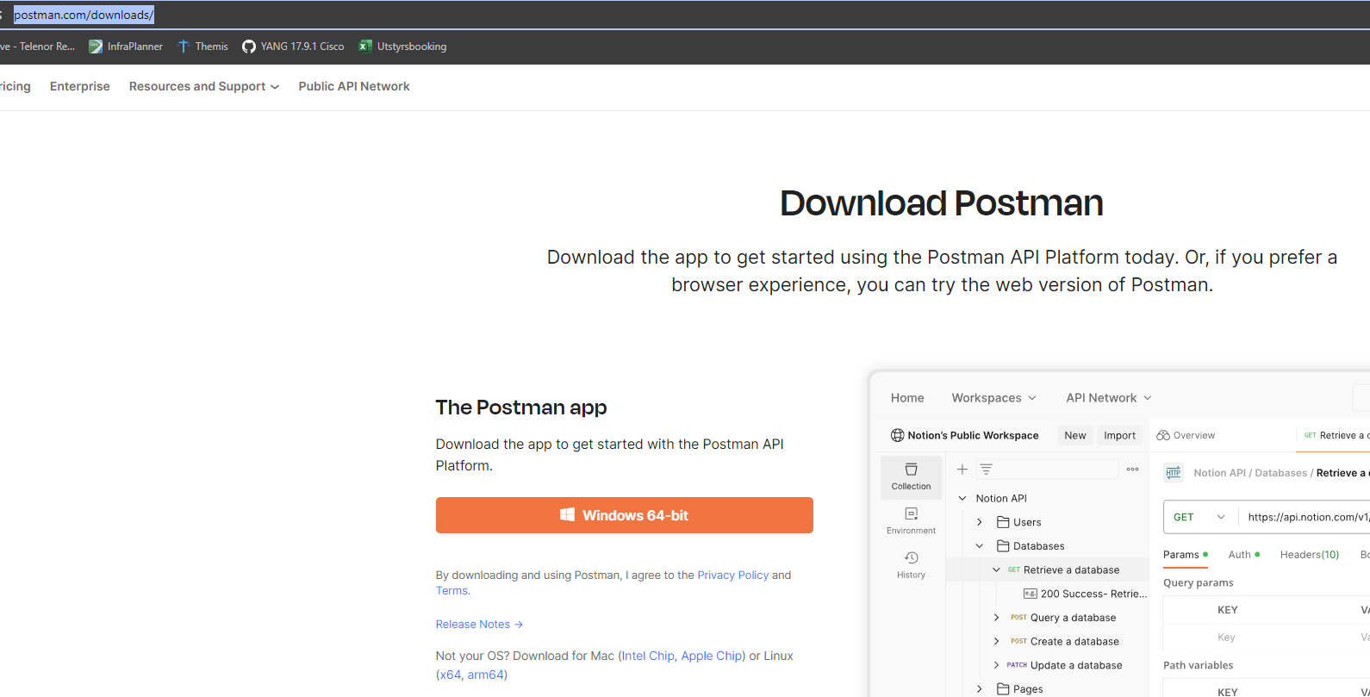
Pre-lab task #4: Install Postman on your laptop
Pre-lab task #4: Postman
Download and follow the instructions on
https://www.postman.com/downloads/

Slide 37
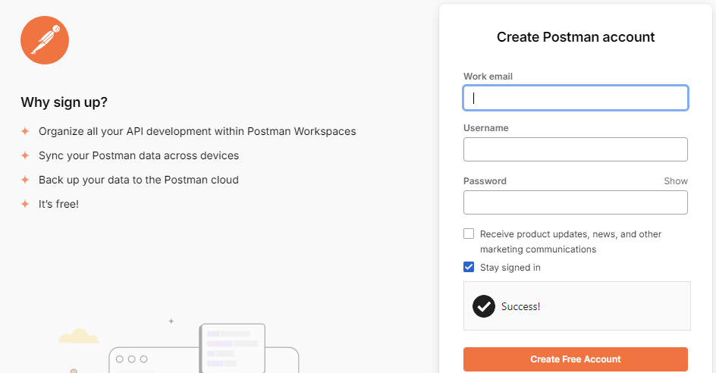


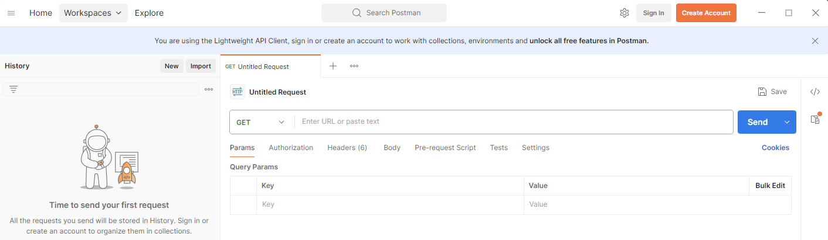
Create a Postman account
Pre-lab task #4: Postman
Create a Postman account
After creating the account, I would always recommend to enable 2FA
Log in to the Postman app using your account

Slide 38
Pre-lab task #5: Install VS Code on your laptop
Pre-lab task #5: VS Code
Download from https://code.visualstudio.com/
Some recommended extensions
Ansible
Python
Remote - SSH
Codeium
A word of caution - beware of fake plugins/extensions
https://www.bleepingcomputer.com/news/security/malicious-vscode-extensions-with-millions-of-installs-discovered/

Slide 39
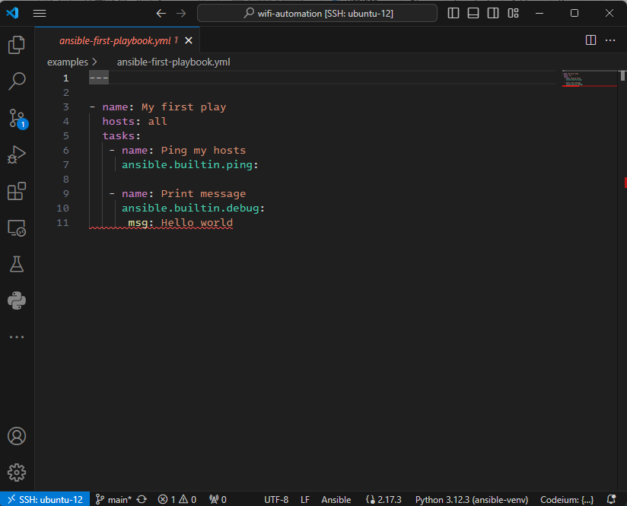




VS Code
Pre-lab task #5: VS Code
Explorer (files etc)
Command palette
Source control (Git):
If you press here you are asked to log in etc. You don't have to do this to complete the lab, it will not be used.
Extensions:
Python
Ansible
Remote - SSH
Some active extension
(Codeium, GitHub Copliot, etc)
Python environment
Language (Python/Ansible/etc)

Slide 40
Pre-lab task #6: 9800-CL (optional)
Pre-lab task #6: 9800-CL
In this task we will install Cisco 9800-CL on VirtualBox
This task is marked as optional, but:
You may do some (most) of the C9800 tasks in the deep dive using a shared WLC instead of having your own
This might be the case if you have a weak laptop, are using MacOS, or are primarily interested in the non-Cisco stuff from the lab
!!! Note !!!
The virtual WLC is NOT a big fan of the host computer entering sleep mode. So you should do a "power off" on the 9800 VM before sleeping your laptop

Slide 41

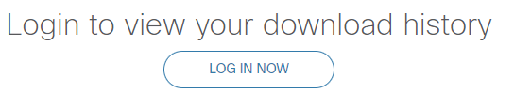
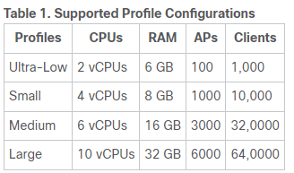
Pre-lab task #6: 9800-CL (optional)
Pre-lab task #6: 9800-CL
Start by downloading the software
https://software.cisco.com
"Access downloads"
Log in
9800-CL version 17.15.1 is used in this lab. Download the ISO image
Any recent version should work, but if we use the same version the APs don't have to download software if changing WLCs
If you do not have access to Cisco Software, you can use the shared 9800 wlc9 (see topology map)
Example uses Ultra-low specs
RAM: 6144MB
Processors: 2
HDD: 16GB

Slide 42
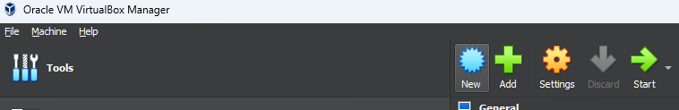
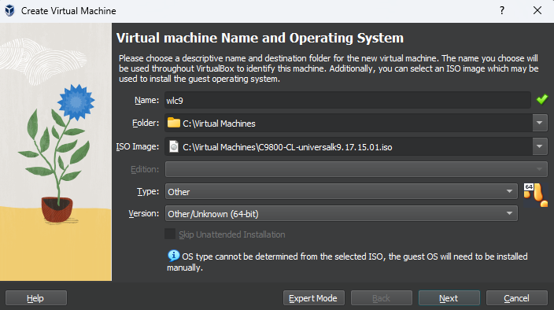
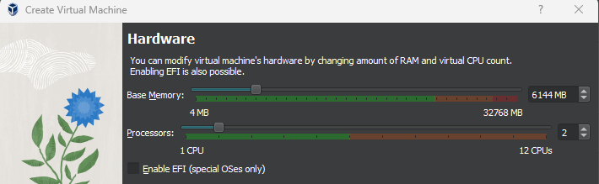
Create VM
Pre-lab task #6: 9800-CL
Change the name to reflect
your pod number. E.g.
wlc11
wlc12
wlc13
etc

Slide 43


Create VM
Pre-lab task #6: 9800-CL

Slide 44



Modify VM
Pre-lab task #6: 9800-CL
Important

Slide 45


Modify VM
Pre-lab task #6: 9800-CL

Slide 46


Modify VM
Pre-lab task #6: 9800-CL

Slide 47


Modify VM
Pre-lab task #6: 9800-CL
Important

Slide 48


Modify VM
Pre-lab task #6: 9800-CL
Important

Slide 49


Modify VM
Pre-lab task #6: 9800-CL

Slide 50



Run VM
Pre-lab task #6: 9800-CL
Take some minutes to boot...
It looks like this when first boots are completed and ready for config:

Slide 51


Configure WLC
Pre-lab task #6: 9800-CL
Type "no" to enter initial configuration dialog
Enter your enable secret twice (from topology sheet or create your own)
Enter "0" to return to CLI without saving

Slide 52

Pre-lab task #6: 9800-CL
Copy this to Notepad++
Replace {pod-number} with number
Then paste in conf mode on 9800:
Initial config
Copy the config script
Replace the text {pod-number} with your pod number
It should be 5 occurences
Hostname: hostname wlc{pod-number}
IP: ip address 192.168.10.{pod-number}
SSID name: wlan lab-network 17 lab-network{pod-number}
Mobility group: wireless mobility group name automationlab{pod-number}
RF-group: wireless rf-network automationlab{pod-number}
The first section (40ish lines) must be manually entered, then connect using SSH
The second section can be copy-pasted after connecting to WLC with SSH
You should change the country code from NO to your country, or to CZ for local compliance
The last line should be pasted alone after the rest is finished
!!! Enter this manually to get SSH up and running !!!
enable
conf t
hostname wlc{pod-number}
ip domain name automationlab.local
crypto key generate rsa
4096
!
vlan 10
name management
!
interface Vlan 1
shutdown
!
interface vlan 10
description management
ip address 192.168.10.{pod-number} 255.255.255.0
no shutdown
!
interface GigabitEthernet1
shutdown
description Uplink
switchport trunk allowed vlan 10,11
switchport mode trunk
switchport trunk native vlan 10
no shutdown
!
ip default-gateway 192.168.10.1
ip route 0.0.0.0 0.0.0.0 192.168.10.1
aaa new-model
username devnet-adm privilege 15 algorithm-type sha256 secret ChangeMe2024!
enable algorithm-type sha256 secret ChangeMe2024!
aaa authentication login default local
aaa authentication enable default enable
line vty 0 30
privilege level 15
logging synchronous
transport input ssh
!
!!! Log in with SSH, then you can copy-paste the rest !!!
conf t
!
interface GigabitEthernet2
description Out-of-Band
shutdown
!
interface GigabitEthernet3
description HA-sync
shutdown
!
vlan 11
name lab-network
!
do terminal length 40
ip dhcp bootp ignore
no service pad
no pae
service tcp-keepalives-in
service tcp-keepalives-out
ntp server 40.119.148.38
service timestamps debug datetime msec localtime
service timestamps log datetime msec localtime
service password-encryption
aaa session-id shared
aaa authorization exec default local
clock timezone CET 1 0
clock summer-time CEST recurring last Sun Mar 2:00 last Sun Oct 3:00
ip http server
ip http authentication local
ip http secure-server
no logging console
no logging monitor
logging buffered 40960
configuration mode exclusive auto
errdisable recovery cause all
errdisable recovery interval 600
ip name-server 1.1.1.1 8.8.8.8
ip ssh time-out 15
!
line con 0
exec-timeout 5 0
logging synchronous
stopbits 1
line vty 0 30
exec-timeout 60 0
privilege level 15
logging synchronous
transport input ssh
!
wireless mobility group name automationlab{pod-number}
wireless mobility dscp 0
!
wireless rf-network automationlab{pod-number}
wireless client max-user-login 3
ap dot11 5ghz shutdown
ap dot11 2 shutdown
wireless country NO
no ap dot11 2 shutdown
no ap dot11 5 shutdown
!
wireless management interface vlan10
!
wireless profile flex lab-flex-profile
native-vlan-id 10
vlan-name 10
vlan-id 10
vlan-name 11
vlan-id 11
!
ap profile lab-ap-profile
mgmtuser username devnet-adm password 0 ChangeMe2024! secret 0 ChangeMe2024!
ssh
!
wireless tag site lab-site-tag
no local-site
flex-profile lab-flex-profile
ap-profile lab-ap-profile
!
wlan lab-network 17 lab-network{pod-number}
radio policy dot11 5ghz
security ft over-the-ds
wmm require
security wpa psk set-key ascii 0 ChangeMe2024!
no security wpa akm dot1x
security wpa akm psk
no shutdown
!
wireless profile policy lab-policy
no central authentication
no central dhcp
no central switching
dhcp-tlv-caching
http-tlv-caching
vlan 11
no shutdown
!
wireless tag policy lab-policy-tag
wlan lab-network policy lab-policy
!
ap filter name lab-filter-rule
ap name-regex .
tag policy lab-policy-tag
tag rf default-rf-tag
tag site lab-site-tag
ap filter priority 100 filter-name lab-filter-rule
!
password encryption aes
key config-key password-encrypt
PasswordForDecryptForAutomationLab!
PasswordForDecryptForAutomationLab!
!
!
exit
!
!
! The last line should be pasted alone, after the rest is finished
!
wireless config vwlc-ssc key-size 2048 signature-algo sha256 password 0 CertPasswordAutomationLab

Slide 53

Prepare WLC for API connections
Pre-lab task #6: 9800-CL
Enable NETCONF, RESTCONF, and create the users
Enable Role-Based Access Control and create some RO users
Note about the last command
Some times it will take a couple of minutes before the command is "ready to run". Try later if you get an error
username restconf-adm privilege 15 secret restconf-pass
username netconf-adm privilege 15 secret netconf-pass
netconf-yang
restconf
ip http secure-server
aaa authorization exec default local
username restconf-read privilege 1 secret restconf-read
username netconf-read privilege 1 secret netconf-read
exit
request platform software yang-management nacm populate-read-rules privilege 1

Slide 54
Pre-lab task summary
Pre-lab task summary
You should now be ready for the deep dive labs, by having installed
VirtualBox
Virtual Mahine 1: 9800-CL
Virtual Machine 2: Ubuntu Server w/Docker
Postman
VS Code w/some extensions

